Slide 1
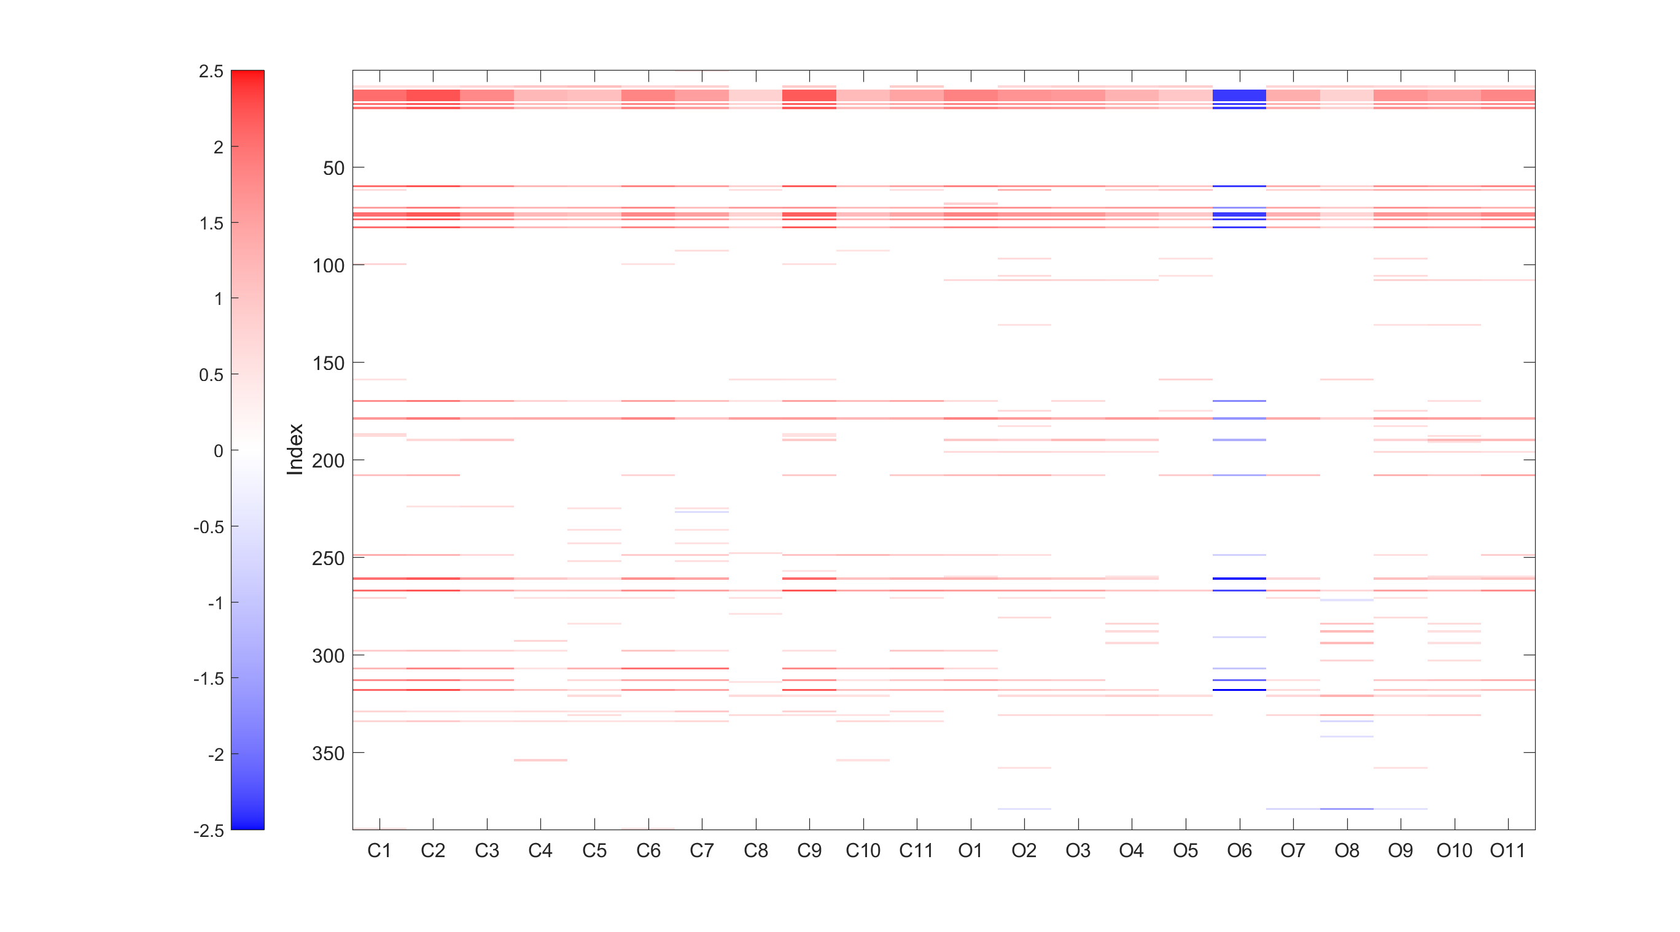



Font Size: 12
Extended in Figure 6
$$p<{10}^{−6}$$
$${10}^{−6}<p<5×{10}^{−6}$$
$$p>5×{10}^{−6}$$
Cocaine
Opioid

Slide 2



Font Size: 15
Extended in Figure 6
$$p<{10}^{−6}$$
$$p<5×{10}^{−6}$$
$$p<{10}^{−5}$$
Cocaine
Opioid

Slide 3
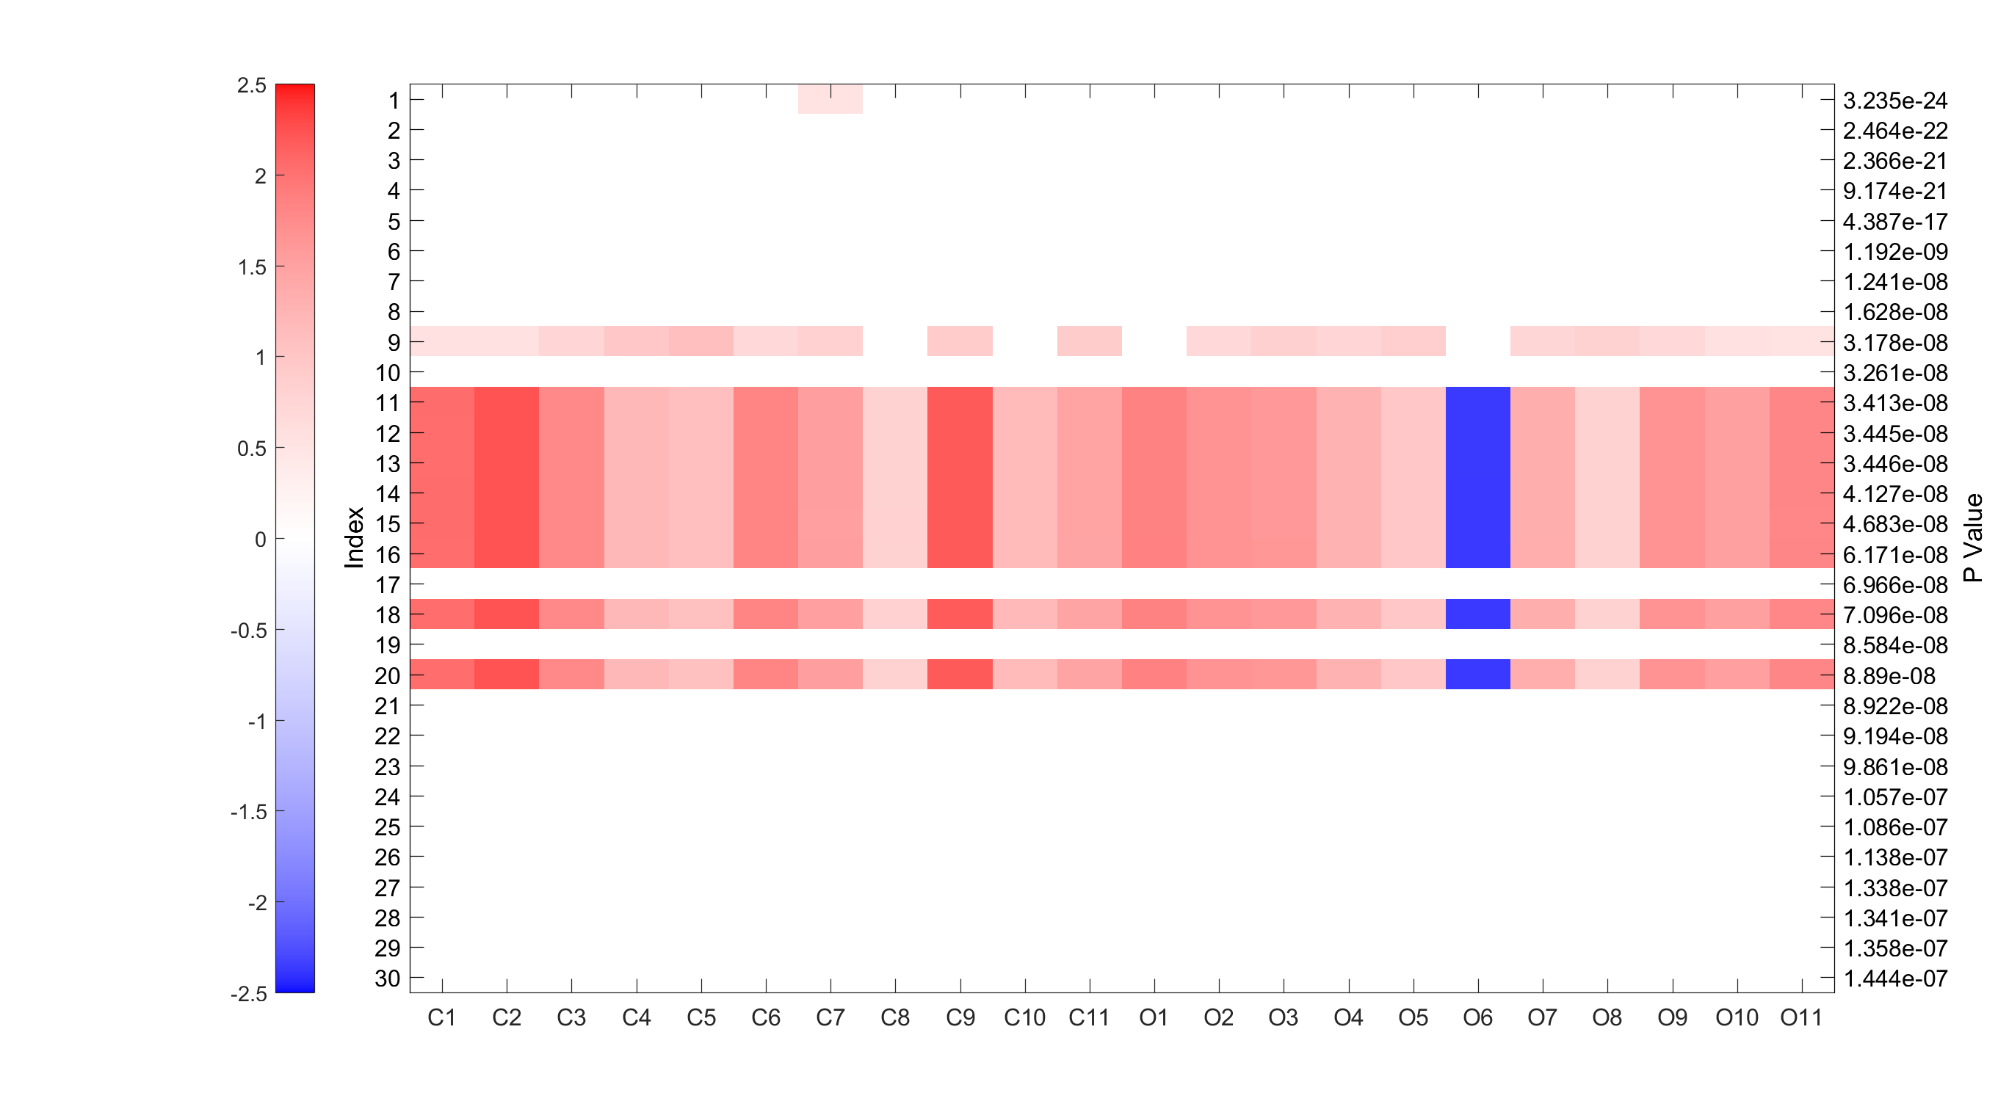
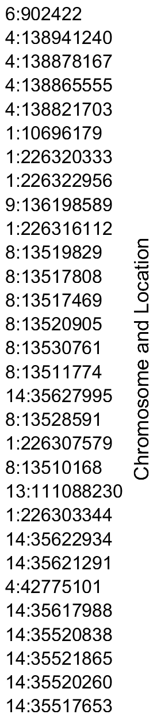
Font Size: 12
Cocaine
Opioid

Slide 4
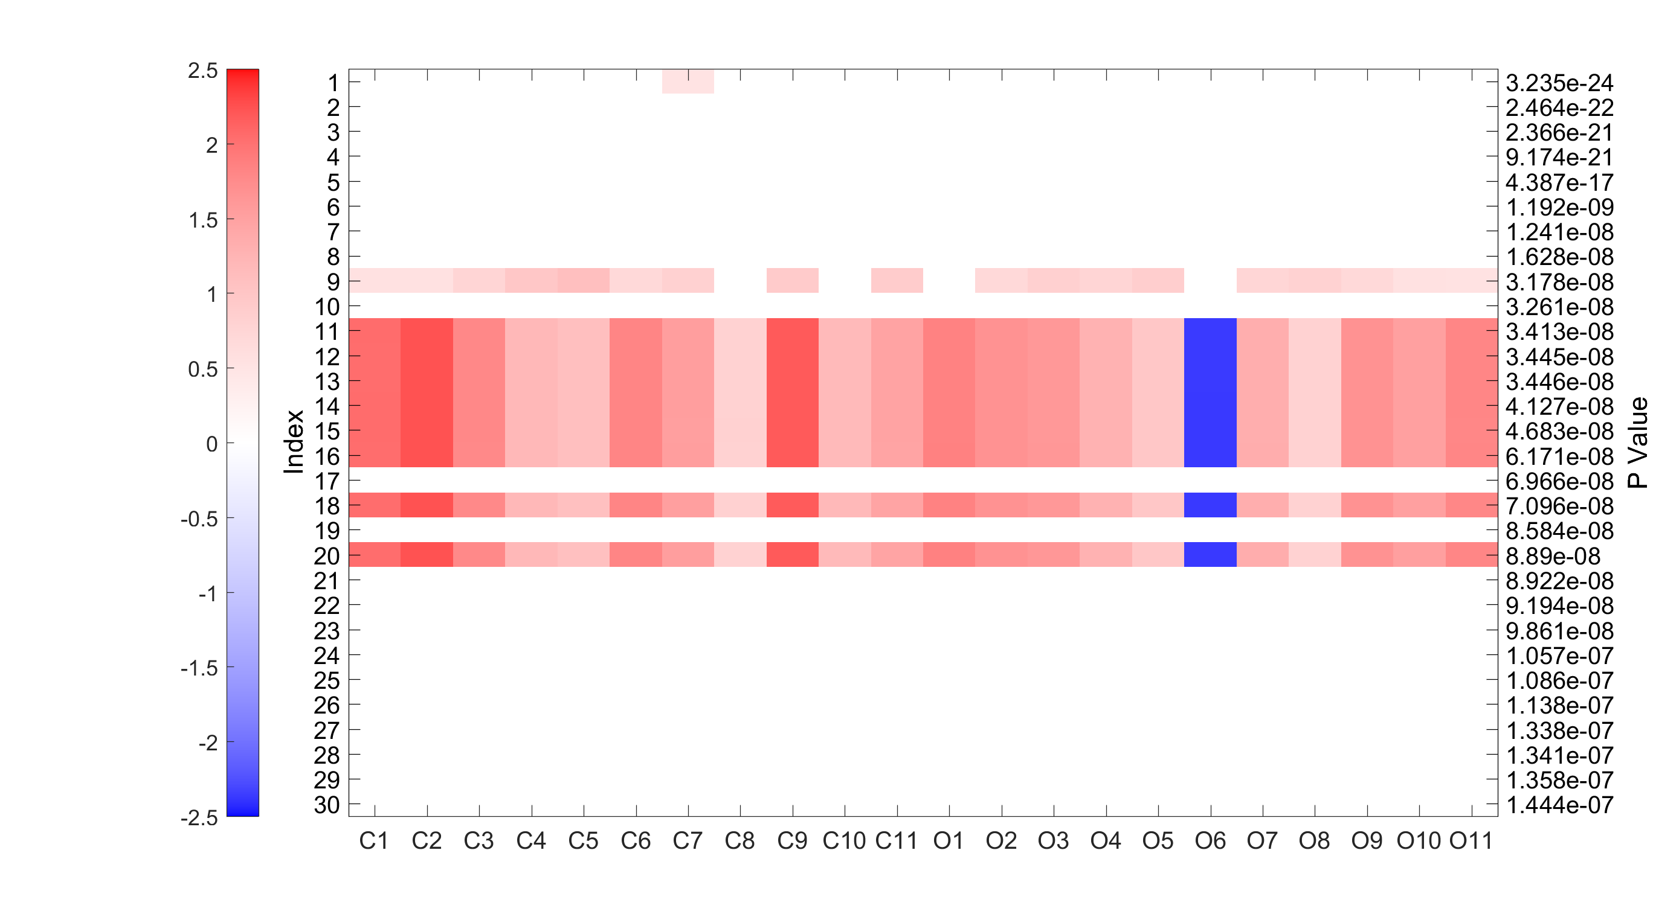
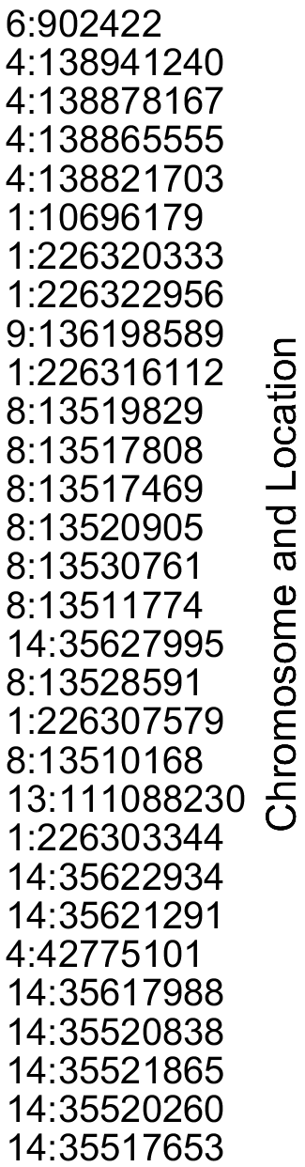
Font Size: 15
Cocaine
Opioid

